Slide 1


Rendering Techniques in Ryse: Son of Rome
Nicolas Schulz
Senior Rendering Engineer
Theodor Mader
Rendering Engineer

Slide 2
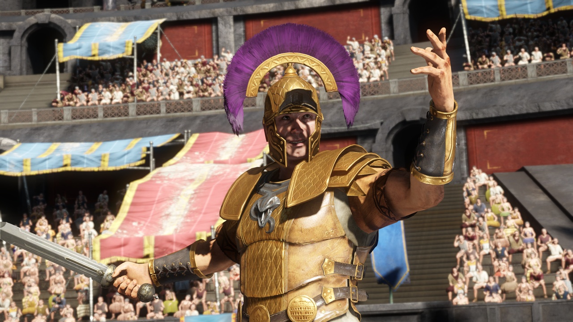
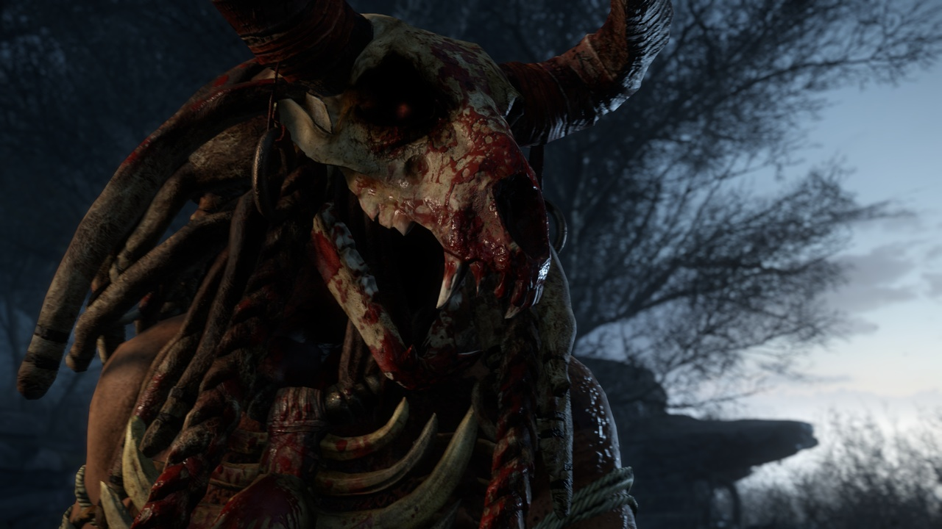
Ryse Rendering Challenges
Major launch title for Xbox One
Visual leap expected for launch title on new platform
Console hardware considerably less powerful than high-end PCs at launch
Previous-gen Crysis 3 impressive looking game on Ultra settings already
Adding just more (effects, higher resolution etc.) not an option on weaker hardware
Just small rendering team fully dedicated to project
Had to focus on what really matters
Strong focus on what you see all the time as opposed to specific features

Slide 3
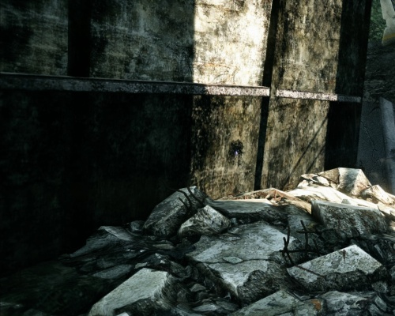
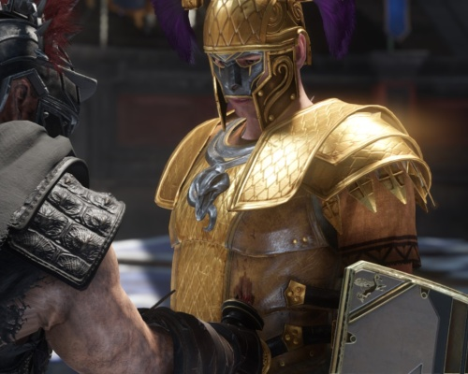
Ryse Rendering Challenges
Wanted to get away from the typical “gamey” look
No real material definition (mostly due to lack of reflections)
Overly high contrast to make flat diffuse materials more visually appealing
Noisy image when specular is used (shading aliasing)
Over-the-top usage of post-processing to cover image quality deficiencies
Wanted to get a step closer to the aesthetics and quality of CG films
Well recognizable materials
Clean image with little to no aliasing
Soft lighting, global illumination effects like light bleeding and natural occlusion

Slide 4
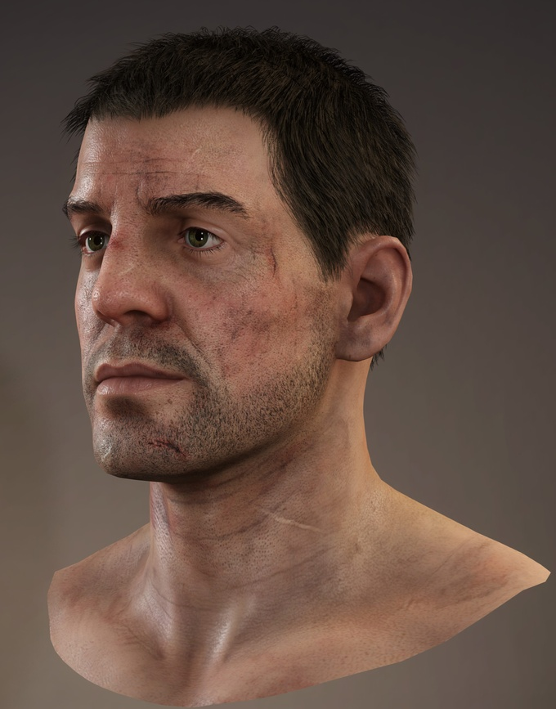
Ryse Rendering Challenges
Main focus during transition to next generation
Physically Based Shading to improve material quality
Consistency of all employed techniques
Visual quality of characters and faces in particular
Anti-aliasing techniques to get more stable and clean image
Enhanced approximations of GI effects
Optimizations to achieve desired quality on Xbox One hardware

Slide 5
Physically Based Shading

Slide 6
Physically Based Shading Review
Models light-material interaction based on real-world behavior
General strong focus on consistency, everything obeys to one well defined rule set
Takes a lot of guesswork out of graphics programming
Considerable implications on several areas
Material Model
Defines clear rules for assets, leading to more art/content consistency
Enforces plausible material parameters and discourages unrealistic setups
Shading Model
More complex BRDFs, Fresnel, normalization of specular highlights, energy conservation in general
Microfacet BRDFs still just limited model of reality
Lighting Model
Have to be careful to preserve material integrity throughout entire pipeline
Physically Based Shading can only work well if it gets respected in all areas

Slide 7
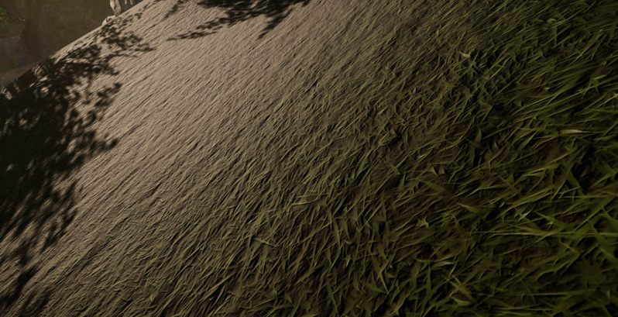
Shading Model Limitations
A lof of effort put into mathematical correctness of models
Mostly on the academic research front
Common analytical specular microfacet BRDFs just limited model of reality
Do not take into account multiple light bounces
Ignore any wave-length dependent absorption on rough surfaces
Extreme case: rough material, low sun, simple planar geometry (no occlusion by backsides)
Tweaks to get more aesthetically pleasing results
Remapped roughness in visibility term to reduce specular gain [BURLEY12]
Started to experiment with incorporating diffuse albedo for specular on rough surfaces
Comparison against real world references useful (e.g. MERL database)

Slide 8
Lighting Model Caveats
Need to be careful to preserve material integrity
Real-world reflection ratios useless if light source can randomly add diffuse contribution without affecting specular
Adding diffuse without corresponding amount of specular will noticeably flatten materials as it effectively decreases the material reflectance F0
Dropped all diffuse-only constant and hemispherical ambient terms for Ryse
No effect on purely specular surfaces (metal)
All indirect lighting captured by localized environment probes that have diffuse and specular cubemaps
Probes stretched over a larger area can lack local light intensity changes, resulting in flat ambient
Introduced multiplicative lights (“ambient lights”) as pragmatic tool for lighting artists to setup bounce lighting and occlusion [SCHULZ14]
Ambient lights affect indirect diffuse and specular equally and preserve reflectance ratio

Slide 9
Occlusion
Occlusion essential part of global illumination
AO important cue to understand spatial relationship between objects
Small-scale occlusion
Screen Space Directional Occlusion
Screen Space Reflections
Larger-scale occlusion
Localized probes with negative ambient lights
Simple shadow map based occlusion system
Special solutions
Prebaked occlusion maps for eyes
Prebaked AO maps for a few assets

Slide 10
Screen Space Directional Occlusion
Fully replaced SSAO by unified screen space directional technique
Directional occlusion encoded using simple SH-like basis
Two bands used independently: Constant and directional part
Constant term applied to indirect diffuse lighting (as in SSAO)
Directional term used for direct lighting
Provides simple contact shadows
Lookup using light vector
Applied to light‘s diffuse and specular contribution
Both parts used for reflection occlusion
Darkens indirect specular
Lookup using view reflection vector

Slide 11
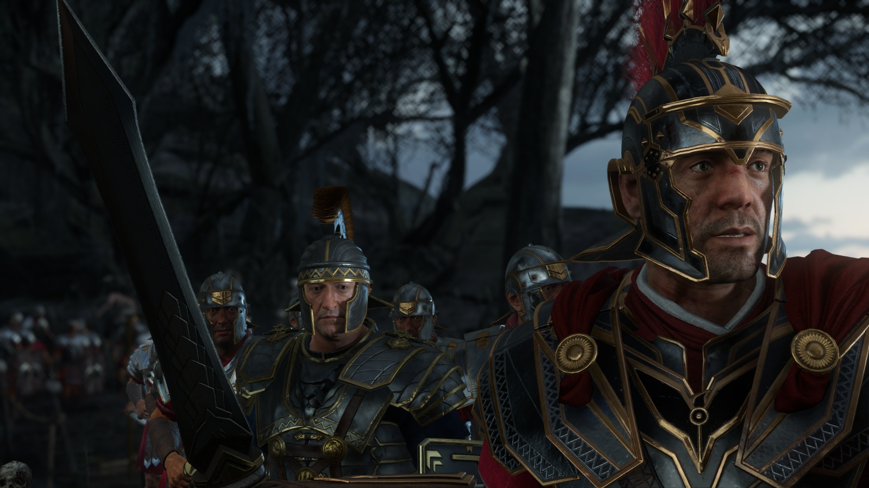
Reflection Occlusion
Enabled

Slide 12
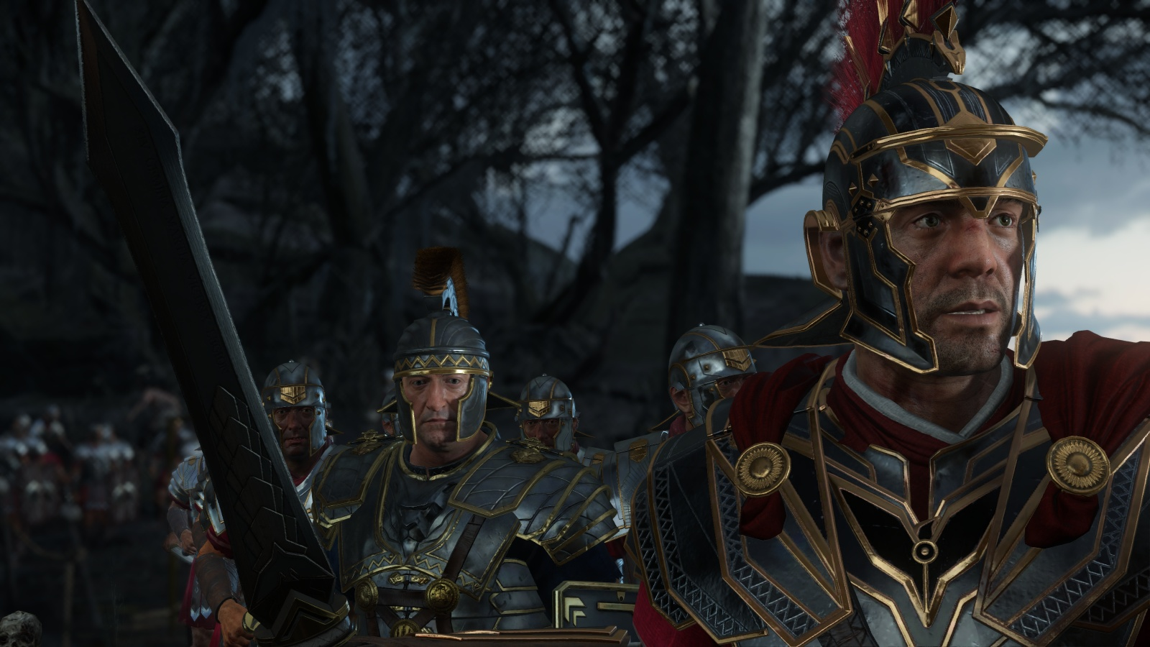
Reflection Occlusion
Disabled

Slide 13
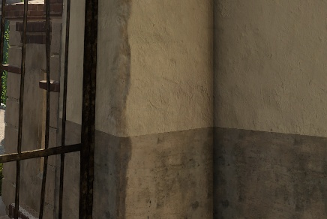
AO Color Bleeding
Removing major part of ambient can look too dark
Especially noticeable on bright surfaces where absorption is low (including Caucasian skin)
AO does not take into account that multiple light bounces are happening
Limiting maximum AO darkening helps
But AO will become too weak on darker surfaces
Need to adjust amount of occlusion depending on surface albedo

Slide 14
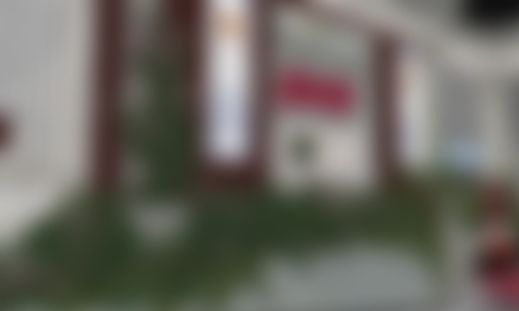
AO Color Bleeding
Simple color bleeding approximation
Last minute feature, had to be very cheap ☺
Generate low-frequency version of albedo buffer as very coarse local scattering approximation
Apply as gamma function to occlusion value
Exaggerated color shift in Ryse to give a slight GI impression float3 occlColor = pow( occlTerm, 1 - min( bleedColor * bleedColor * bleedColor * 3, 0.7 ) );

Slide 15
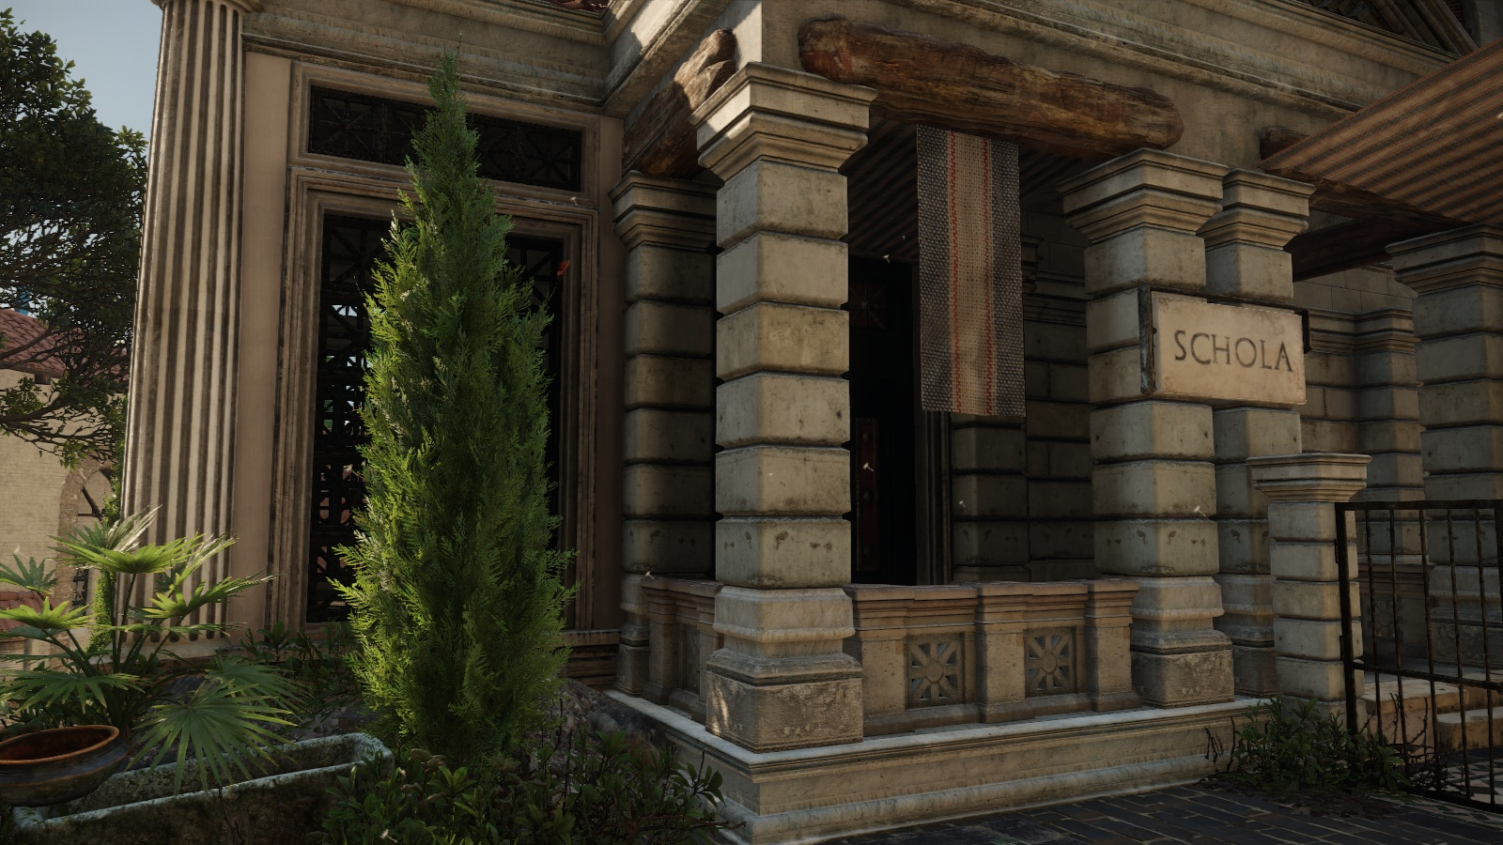
AO Color Bleeding
Disabled

Slide 16
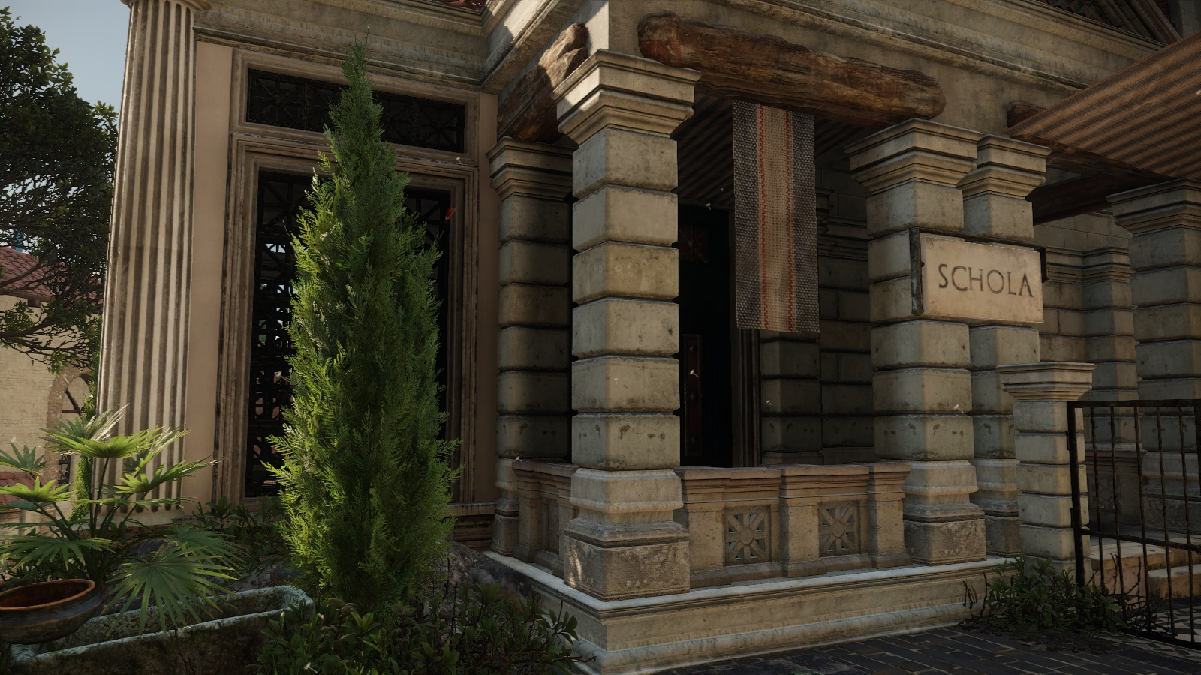
AO Color Bleeding
Enabled

Slide 17
Image Stability

Slide 18
Image Stability
Clean and temporally stable image essential for perceived quality
Visual noise is distracting
Various forms of aliasing that need to be minimized
Geometry aliasing
Shader aliasing
Due to under-sampling, over-sampling, multi-resolution rendering, etc.
Ray-marching (SSR), shadow map sampling, etc.
Addressed by specific solutions on algorithmic level
Usually preferred temporally stable methods over methods that would give slightly higher quality in a static image
Specular aliasing

Slide 19
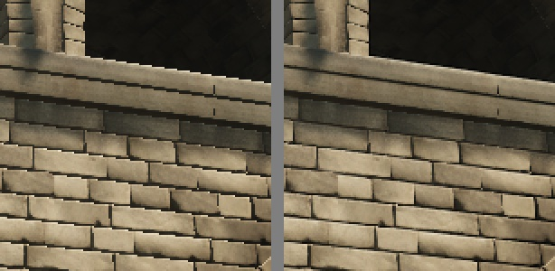
Geometry Aliasing
Spatial aliasing
Infamous jaggies/staircase artifacts
Postprocessing based methods like MLAA, FXAA and SMAA work very well
SMAA used in Ryse [JIMENEZ12]
Temporal aliasing
One of the more serious challenges
Subpixel-sized triangles that are rasterized in one frame but not in a another causing flickering/shimmering
Need more samples per pixel (MSAA, Supersampling)
Supersampling fully supported in Ryse
Used for prerecorded cinematics and available in the PC version

Slide 20
Temporal Geometry Aliasing
MSAA was not an option on Xbox One with deferred shading
Massive bandwidth increase
Running into issues with ESRAM size
2x MSAA not enough for great quality
Need to rely on data from previous frames
Solution we ended up using is new SMAA 1TX [SOUSA13]
Accumulate multiple frames for better temporal stability
Track geometry in previous frames but limit signal changes
Avoids ghosting when pixels from dynamic objects can't be reprojected accurately
Key to avoid overly smooth image is selecting accumulation sample count based on signal frequency
Less samples for low frequency parts of image, more for high frequencies

Slide 21
Specular Aliasing
Physcially Based Shading very prone to specular aliasing
High luminance values from normalized BRDF in combination with high-frequency normal information
Normals and roughness strictly coupled in Ryse
Conceptually connected, normals represent surface bumpiness on macro scale, roughness on micro scale
Roughness stored in normal map alpha channel in source assets
Split into 2 textures by engine (BC5 for normals, BC4 for roughness)
Normal variance of mips baked into roughness maps [HILL12]
Toksvig factor used to estimate variance and derive new roughness [TOKSVIG04]
Problems remain when roughness is modified in GBuffer (decals, rain wetness)
Addressed by applying normal variance filter in screen space [SCHULZ14]

Slide 22
LOD Selection
Improved LOD selection
Compute optimal viewer distance for LOD transitions
Helps to reduce aliasing by avoiding tiny triangles (also improves performance)
Compute average screen-space triangle size
When projected size on screen gets below threshold, mesh is too detailed and next LOD mesh should be used
Average mesh triangle area precomputed offline
Various metrics possible: mean, median, geometric mean, etc.
Opted for geometric mean (log-average)
Many tiny triangles reduce value while a few large triangles barely increase it
Distance for switch just computed for first LOD transition
Subsequent LODs use a multiple of that distance
Prevents that some LOD meshes are completely skipped

Slide 23
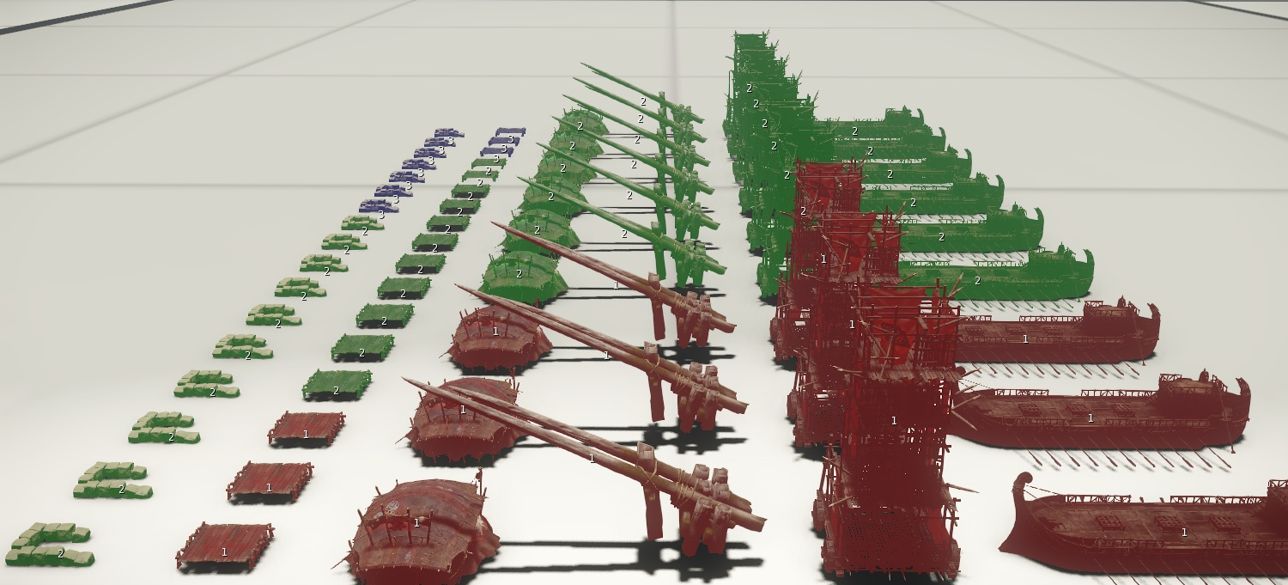
LOD Selection using Object Size
Notes:
Previous system

Slide 24
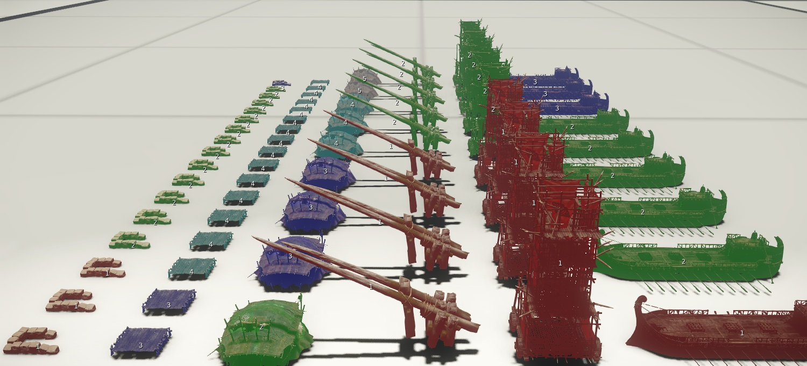
LOD Selection using Triangle Size
Notes:
Some objects are able to switch LOD much earlier than others while conserving visual quality.

Slide 25
Particle Shading

Slide 26
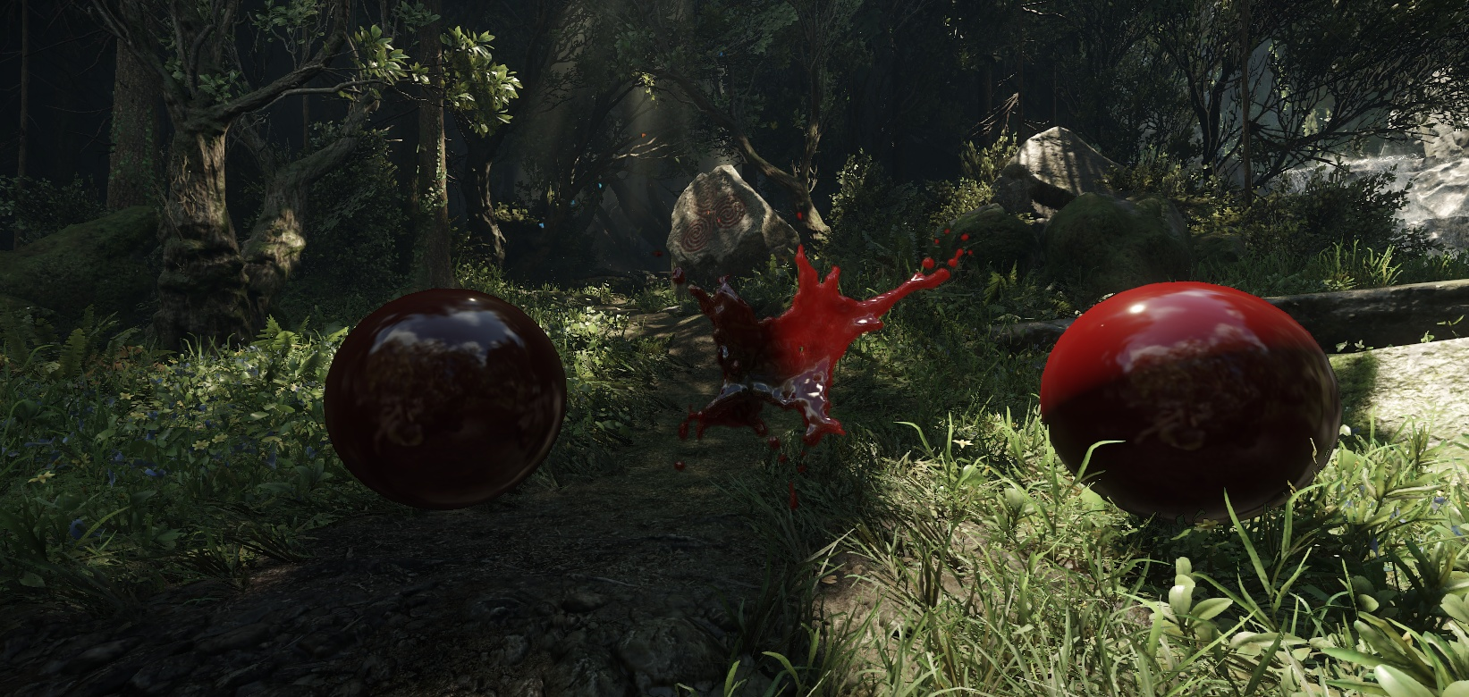
Particle Shading
Main focus on shading consistency with environment
Dropped non physically based terms (e.g. constant ambient)
Sample environment probes instead
Optimization: Use lowest mip-map of specular cubemap for diffuse
Normalized Blinn-Phong for performance reasons
Same physical light falloff as on environment
All particles receive shadows
Forwared rendered particle (middle) embedded in deferred shaded scene

Slide 27
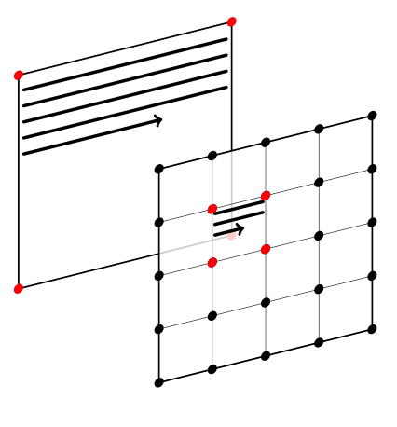
Particle Shading
We accumulate incoming light per vertex or per control point [PERSSON12]
Light intensity
Average light direction weighted by light intensities
Interpolated across entire quad or tessellation patch
Combined with per pixel normal for shading
Significantly faster than per pixel lighting
Still quite slow due to tessellation overhead
Prone to undersampling of high frequency signals
Lights with harsh fall off
Shadows

Slide 28
Shadows

Slide 29
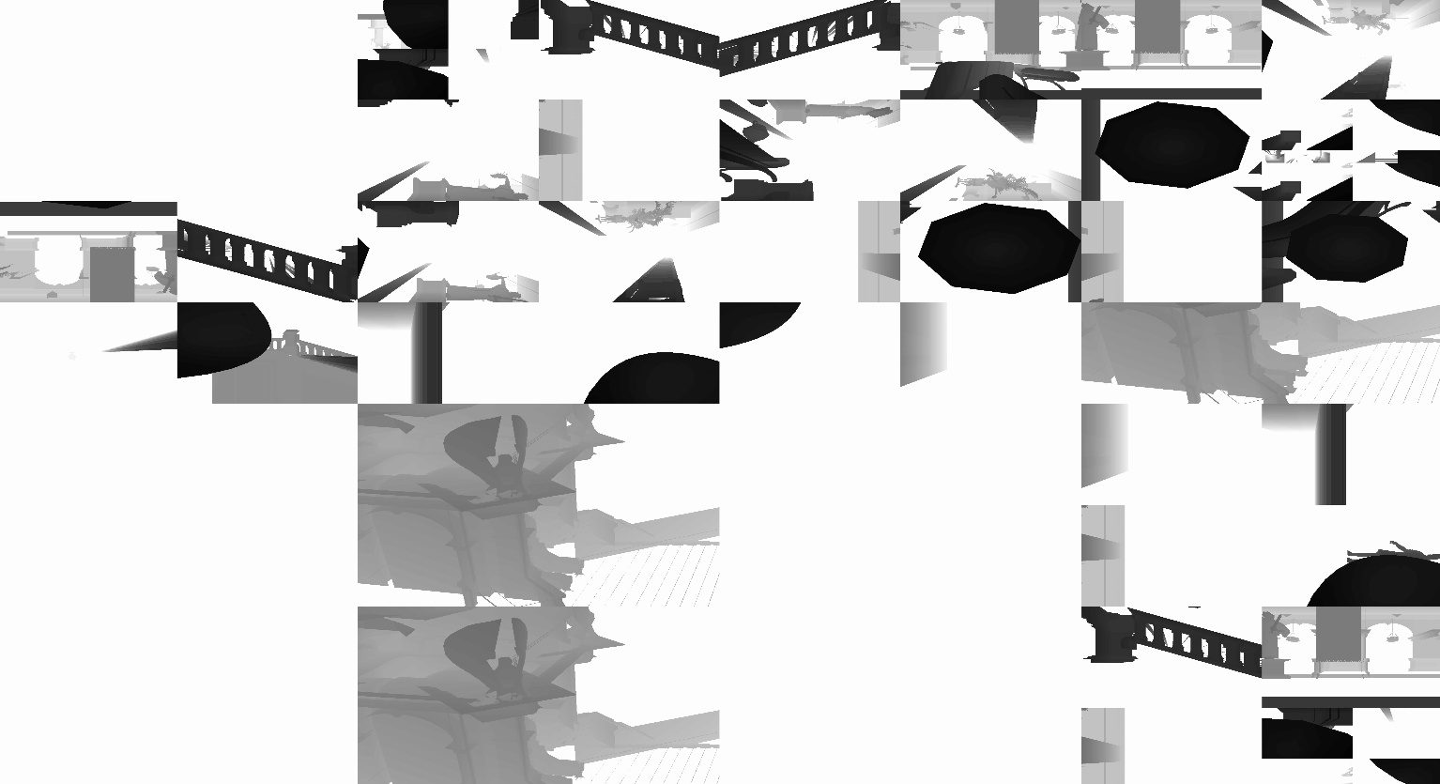
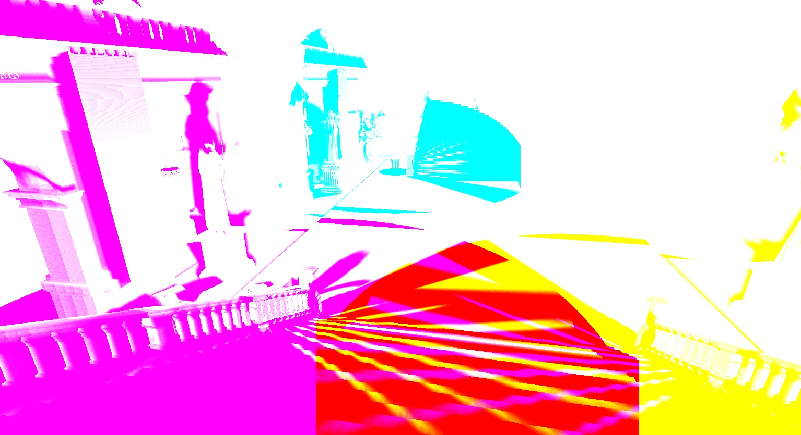
Sun and Point Light Shadows
Cascaded shadow maps for sun
Approximately logarithmic split scheme
Point lights unwrapped into individual projectors
Each projector renders to chunk from large shadow atlas
Chunk resolution dependent on projector importance
Shadow occlusion evaluated in full screen passes and accumulated into “shadow mask” texture array
One color channel per light, channel sharing if possible
Allows efficient stencil culling of shadow receiving area
Reduces GPR pressure in tiled shading pass
Filtering by (per pixel rotated) poisson disk

Slide 30
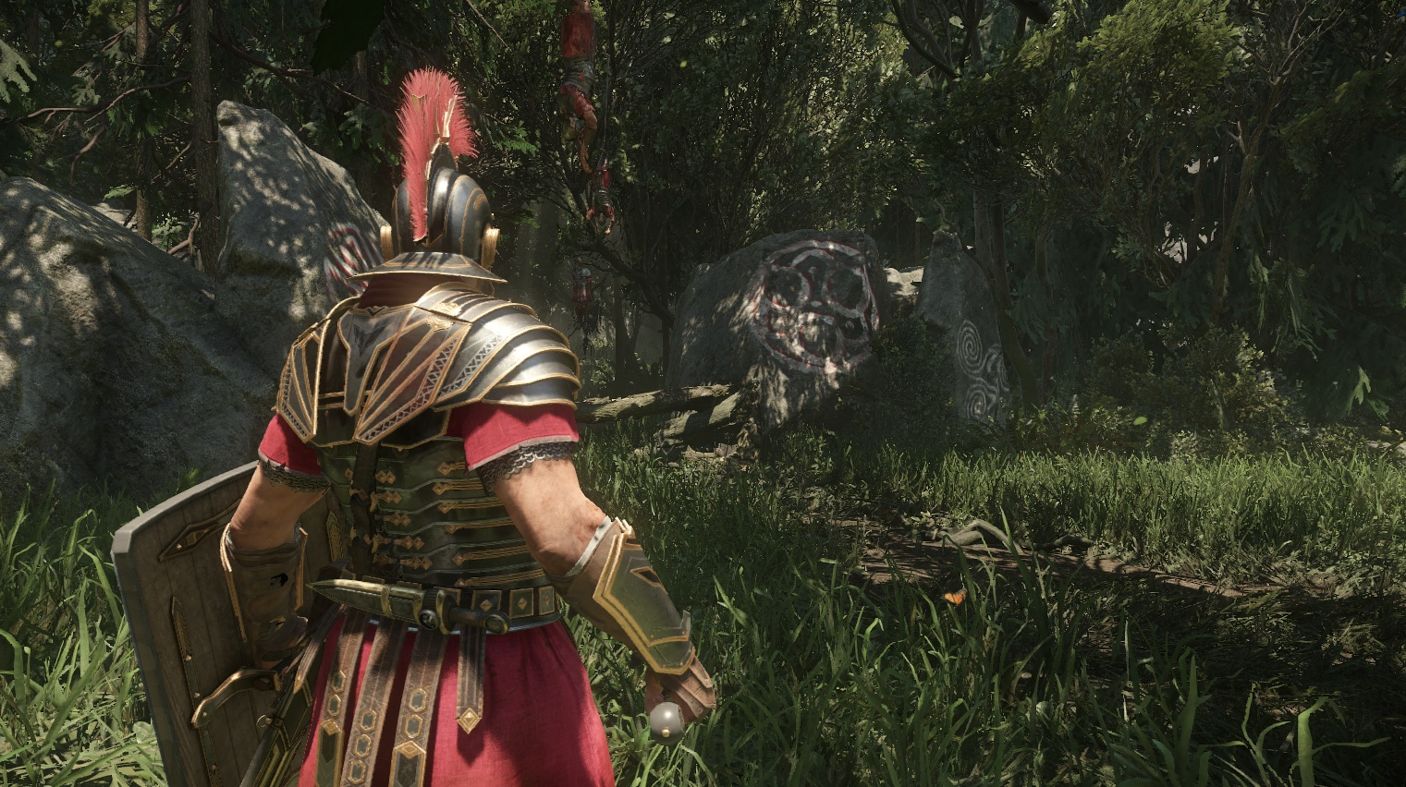
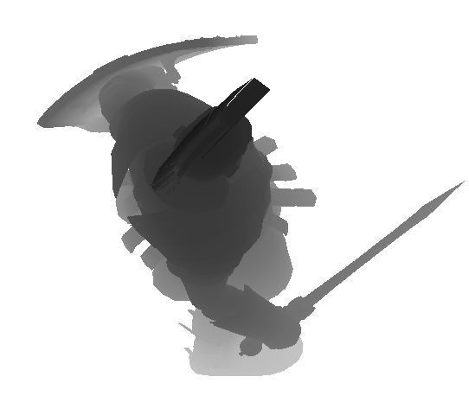
Character Shadows
Third person view
Protagonist in focus at all times
High quality self shadows mandatory
Custom shadow map focused on tight bounding box
Blended into shadow mask with “max” operator

Slide 31
Static Shadow Map
In early development draw calls were a major bottleneck, especially shadows
Major risk for the project
Most shadow draw calls spent on far away cascades
Exponential increase of world coverage
Even true on highly optimized assets under
Aggressive distance culling
Shadow casting disabled where possible
Optimization compromise
No dynamic shadows in distance

Slide 32
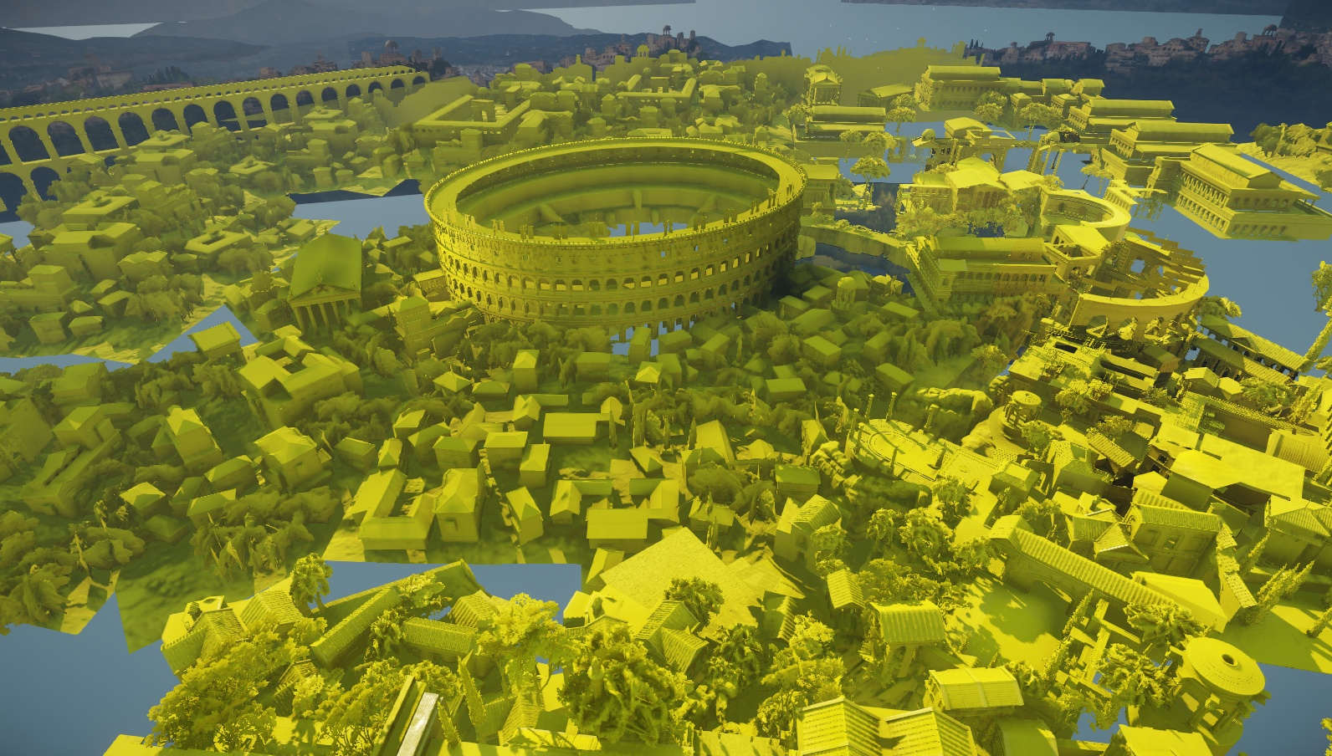
Static Shadow Map
Simple approach: Replace furthest cascades with “static shadow map”
8192 x 8192 pixels at 16 bits per pixel: 128 MB video memory
Each object is rendered only once
Zero shadow draw calls for replaced cascades once static shadow map is filled
World space resolution (pixels per meter) matches or exceeds first replaced cascade
No quality loss in terms of resolution
New undersampling artifacts due to deviation from logarithmic texel distribution
Quite minor in Ryse

Slide 33
Static Shadow Map
Which cascade to choose?
Log split scheme results in exponential storage requirements for fixed world space area
We picked cascade 4 as our best option
Allows us to cover approximately 1.3 km x 1.3 km area without quality loss
Required texture size for 1 km x 1 km area, keeping resolution of first replaced cascade intact (log scale)

Slide 34
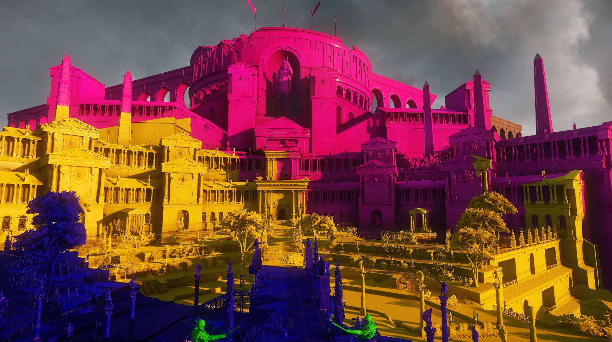
Static Shadow Map
Static shadow map off

Slide 35
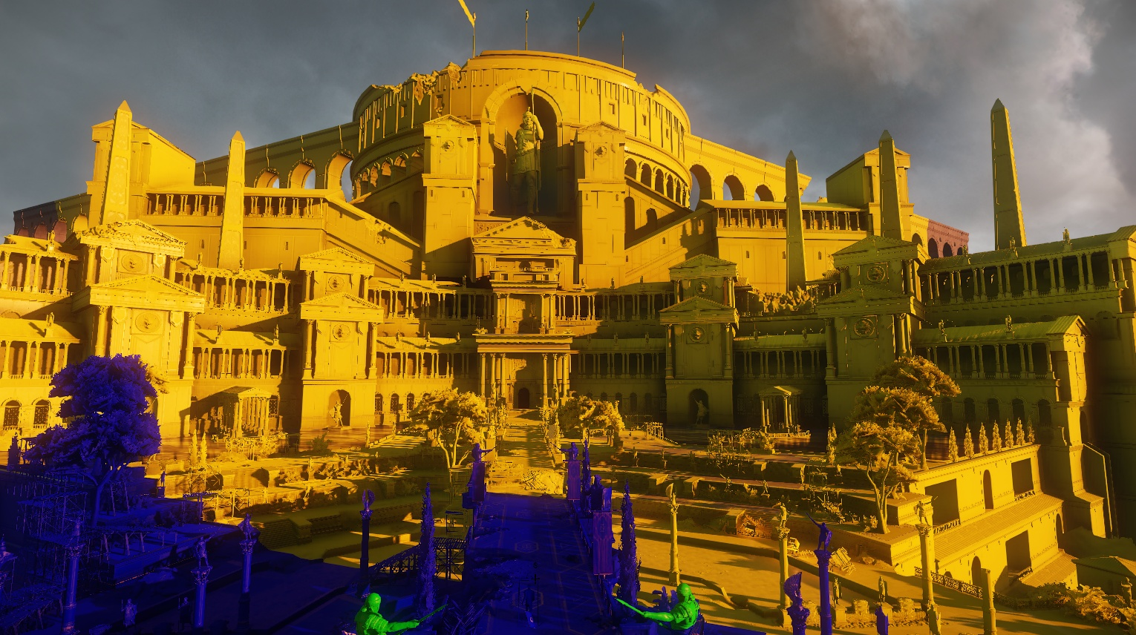
Static Shadow Map
Static shadow map on

Slide 36
Static Shadow Map
Map placement and update controlled by designers and lighting artists
Level checkpoints
Switching between areas
Full update approximately 10-15ms on XBox One
Time sliced update strategy to avoid frame rate spikes
Cap number of draw calls per frame
Streaming option: render object once fully streamed in
Saves approximately 40% - 60% shadow draw calls on optimized assets

Slide 37
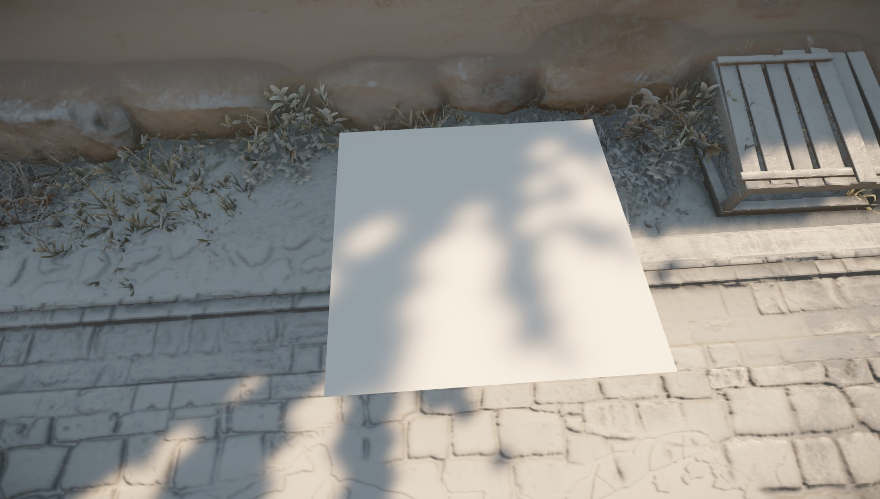
Particle Shadows
Static shadow map used for particle shadowing
Lower frequency: Less prone to undersampling artifacts when sampled per vertex or per control point
Very efficient filtering: 4×4 Gaussian filter kernel
Four fetch4 instructions + some ALU
Avoids sampling multiple cascades
Static shadows on all lit particle effects cheaper than dynamic shadows on select ones

Slide 38
Cinematic Shadows
Needed high quality shadow solution for sun shadows
Started out with Sample Distribution Shadow Maps [LAURITZEN11]
Great results but how to get rid of the read-back?
Too many artifacts with data from previous frame
Avoiding read-back requires either geometry shader (slow!) or entire culling and draw call setup on GPU: too risky
Went with very pragmatic solution
Expose shadow near/far distances in cutscene authoring tools
Fully logarithmic splits between near/far
2048 x 2048 shadow maps to exceed screen resolution

Slide 39
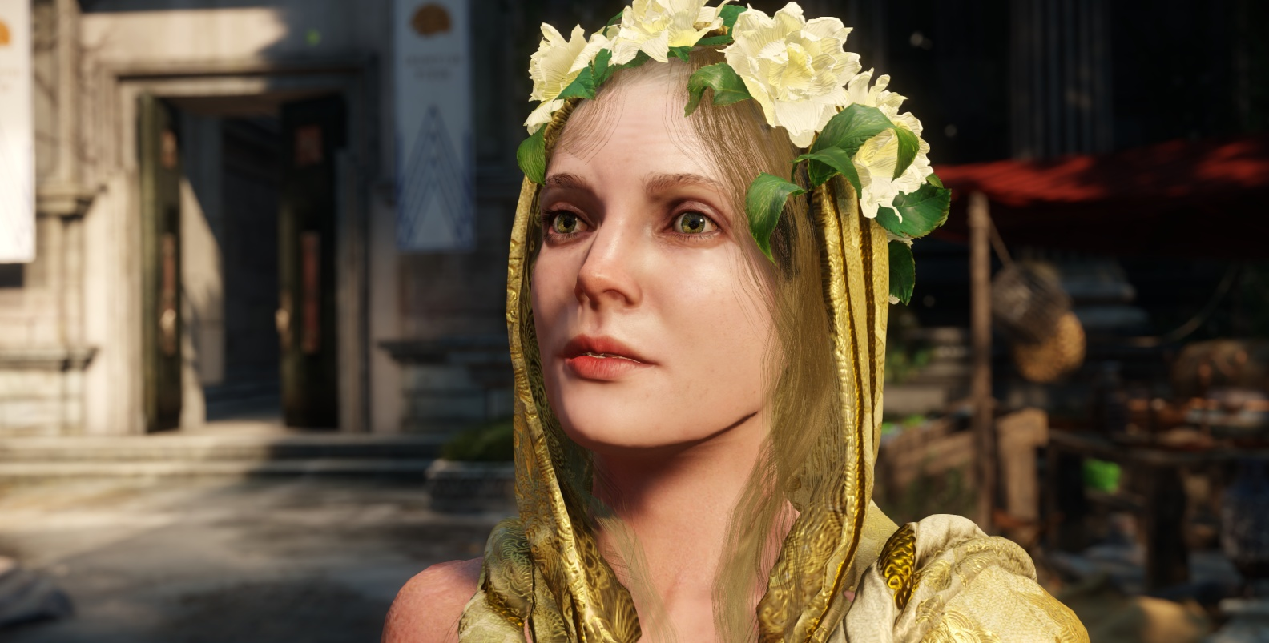
Cinematic Shadows
Cinematic shadows off

Slide 40
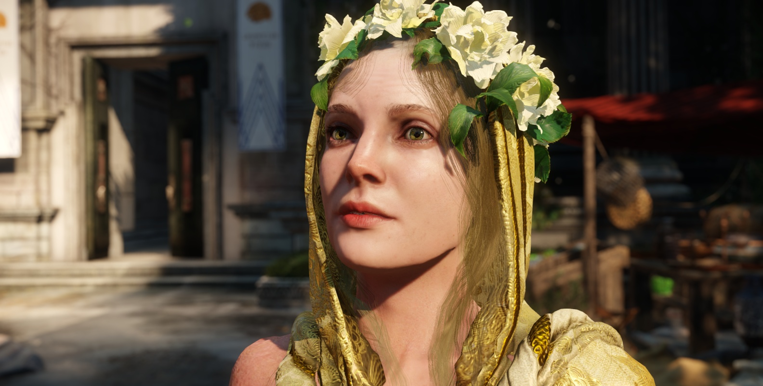
Cinematic Shadows
Cinematic shadows on

Slide 41

Cinematic Shadows

Slide 42
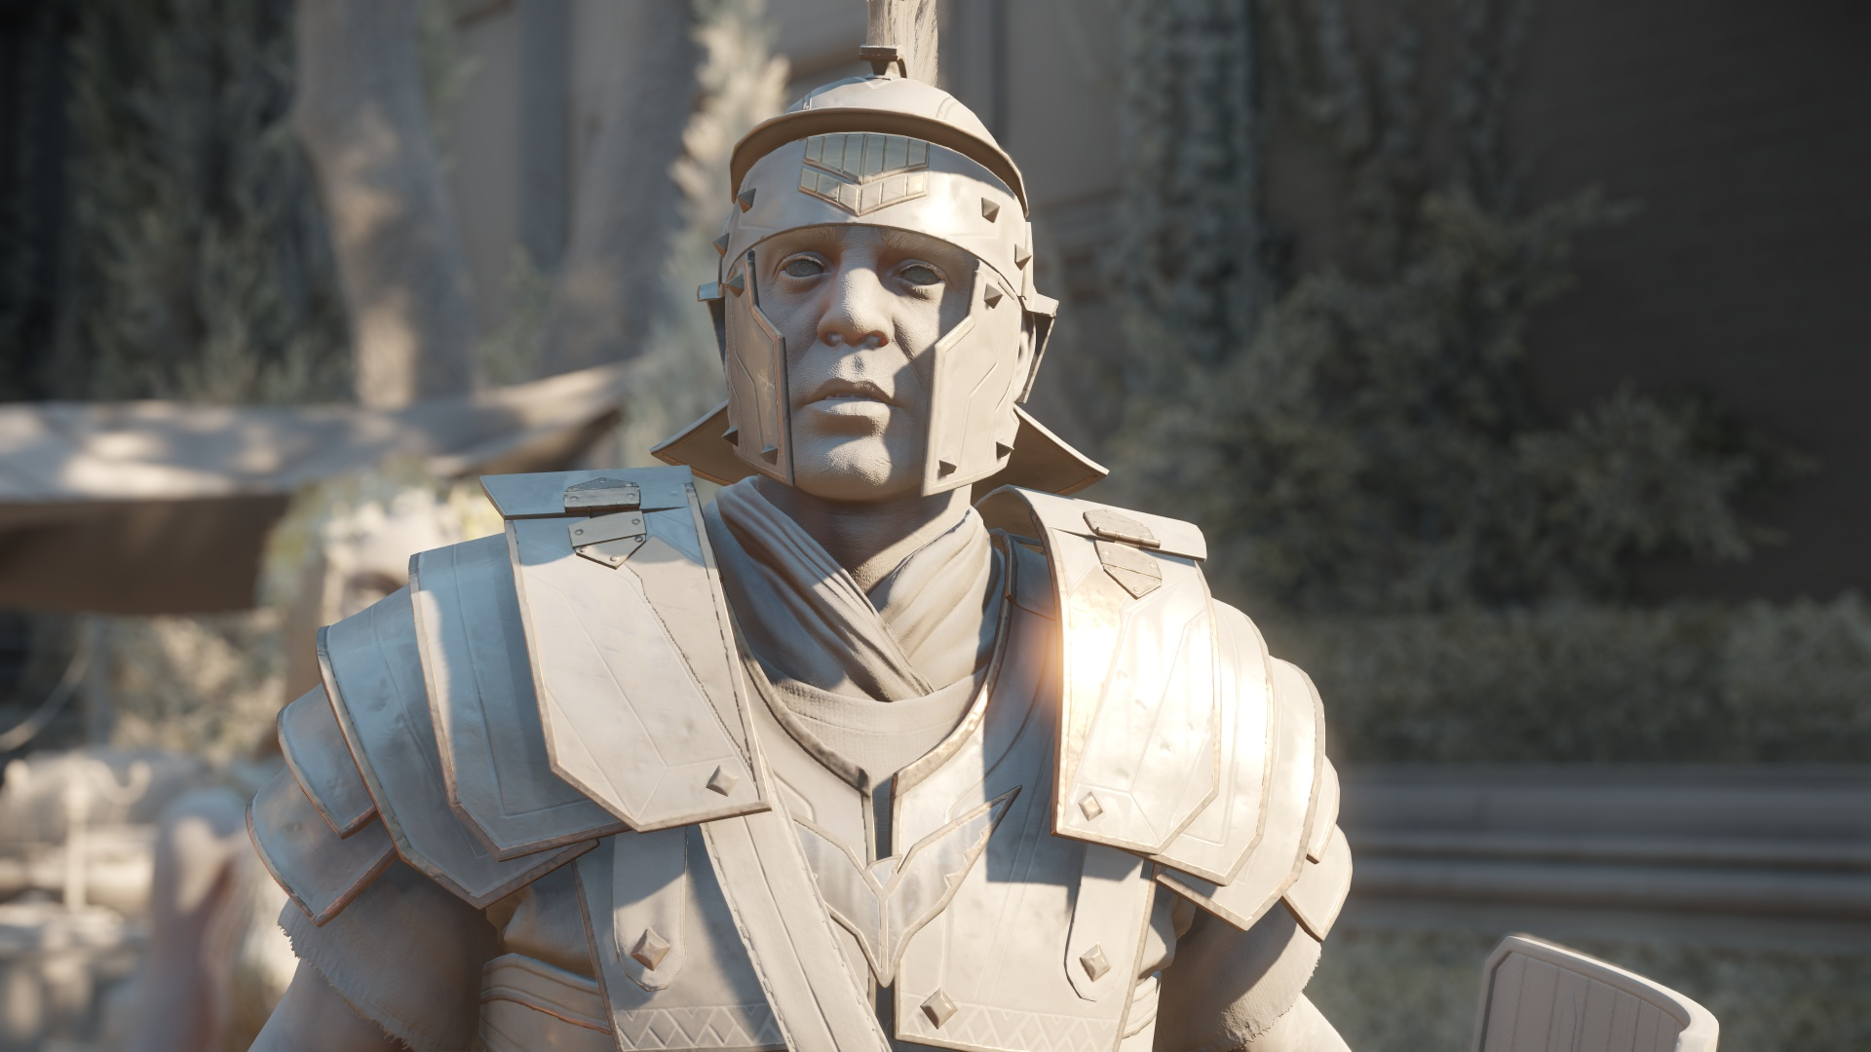

Slide 43
Large Scale AO

Slide 44
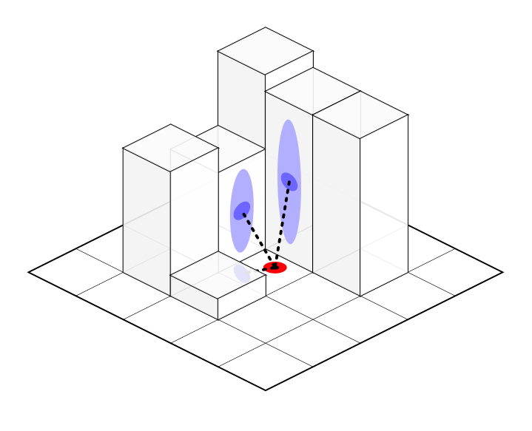
Large Scale AO
Ended up using a method similar to [SWOBODA10]
Render Scene top down into shadow map
Results in a height map approximation
Full screen pass: for each pixel
Project into shadow map space
Sample surrounding pixels and calculate occlusion with AO algorithm of choice

Slide 45
Large Scale AO
Main focus on capturing largest scale features
Low resolution shadow map (approximately 0.5 meter per pixel)
2048 x 2048 sufficient for 1 km by 1 km area
AO kernel sampling radius: 7.5 meters
Ryse doesn’t have moving objects at that scale
Same update strategy as static shadow map
Very low frequency effect
Got away with 4 (interleaved) samples per pixel
Could easily be done in half or quarter res
Got slightly better performance by merging with regular SSDO pass

Slide 46
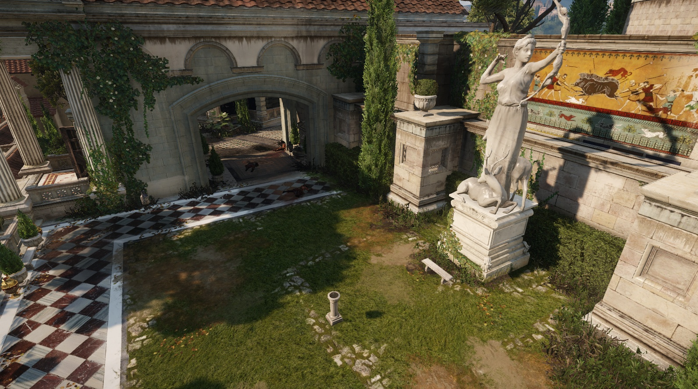
Large Scale AO
Large Scale AO off

Slide 47
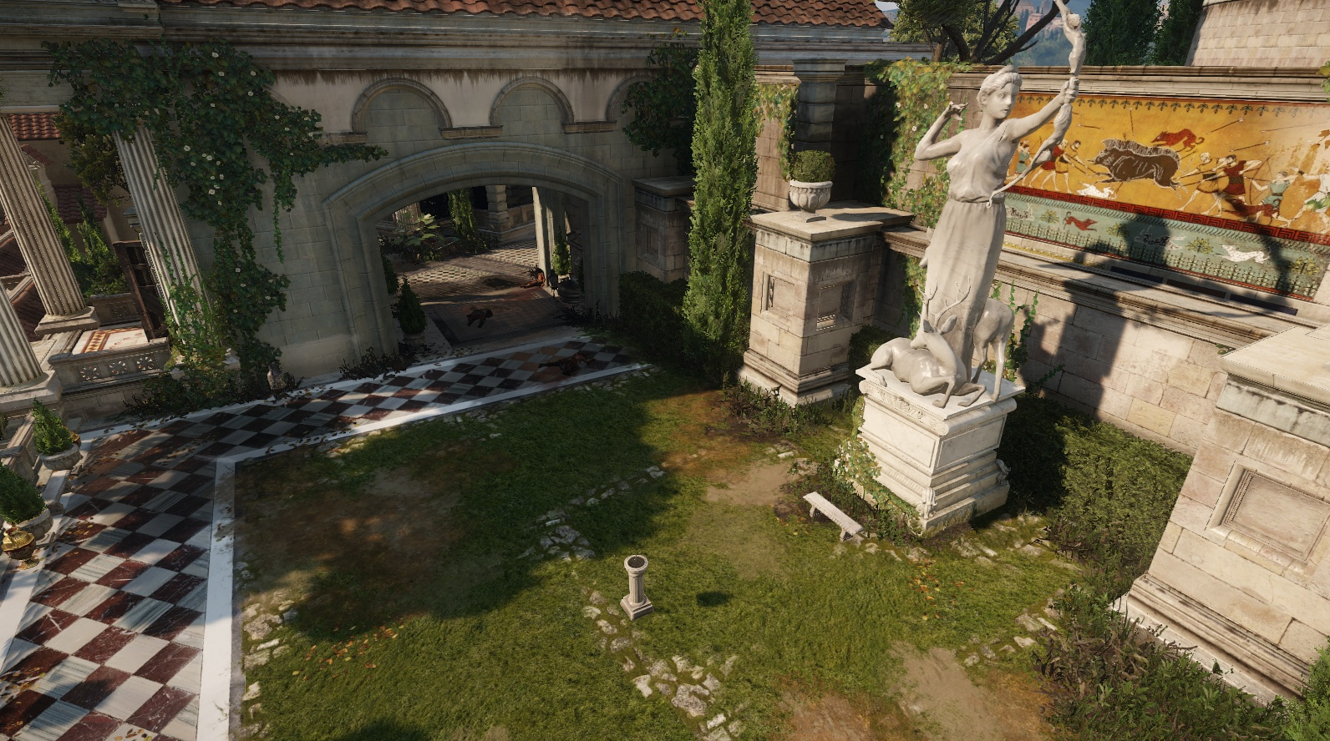
Large Scale AO
Large Scale AO on

Slide 48
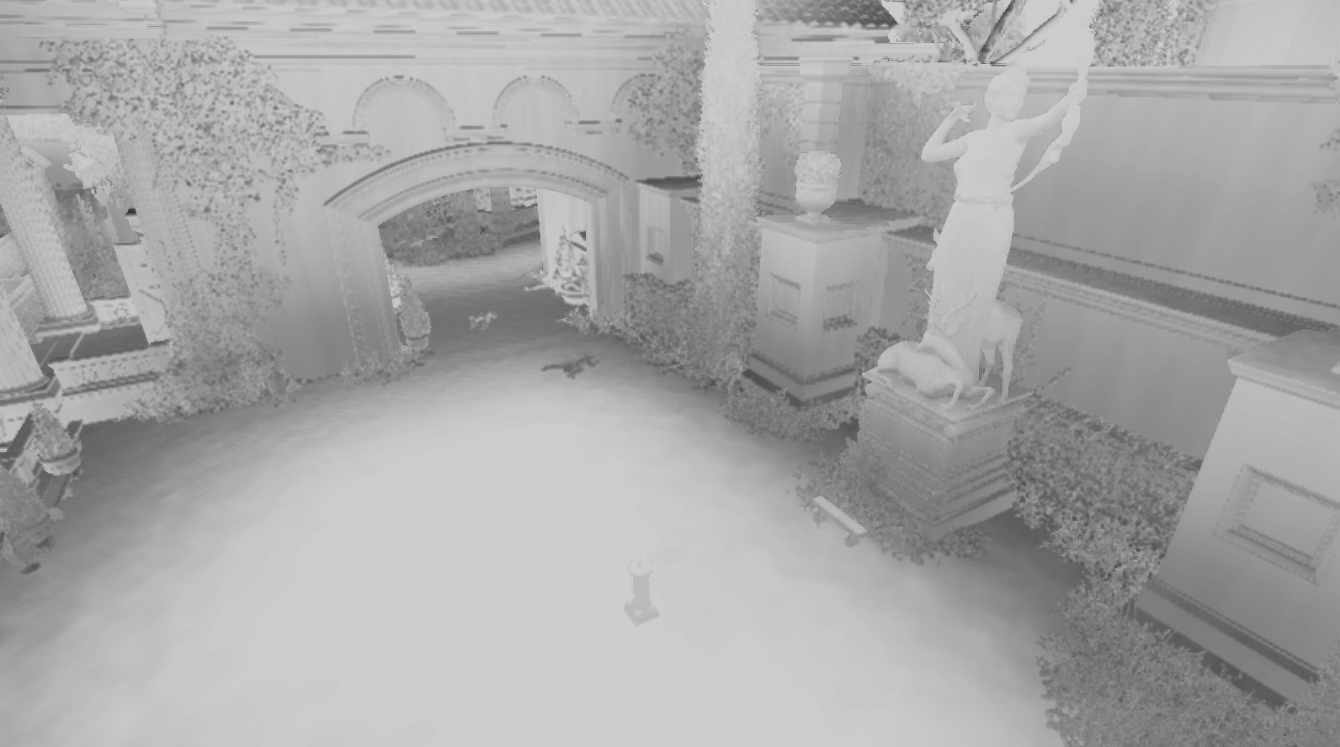
Large Scale AO
Large Scale AO contribution [contrast enhanced]

Slide 49
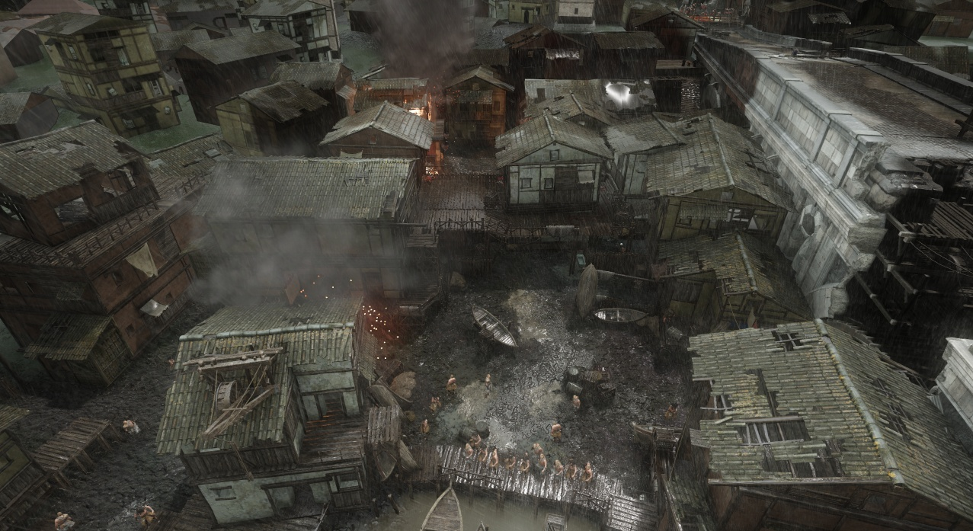
Large Scale AO
Large Scale AO off

Slide 50
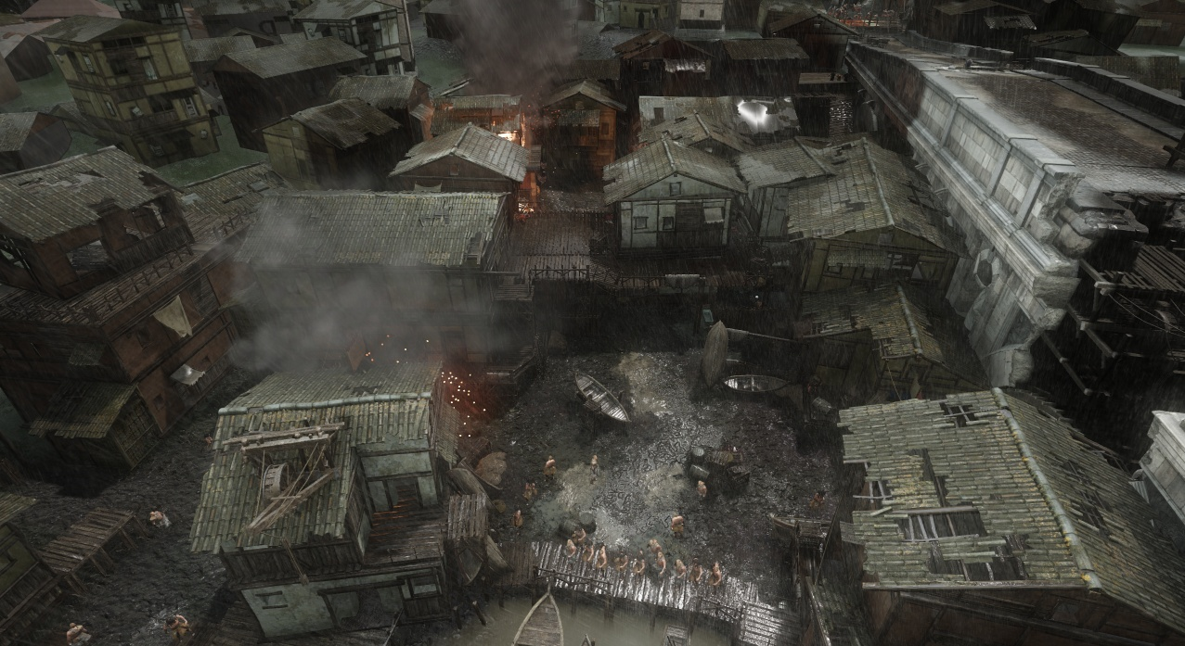
Large Scale AO
Large Scale AO on

Slide 51
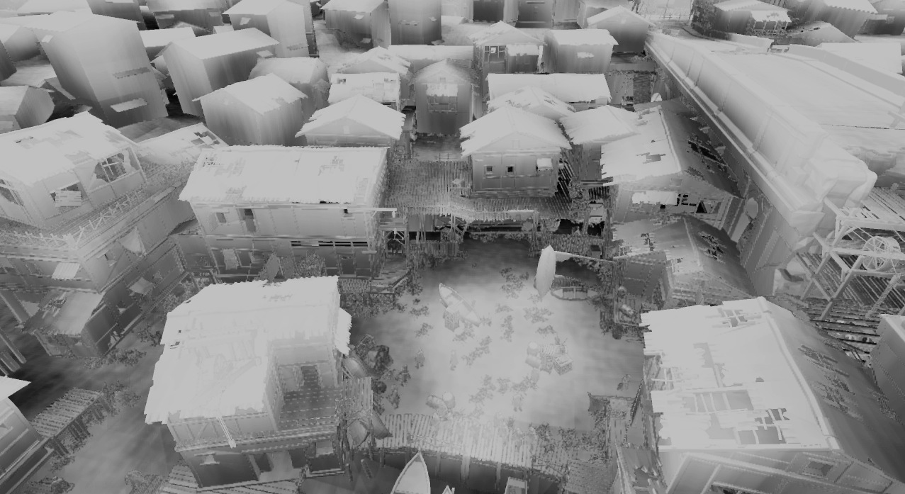
Large Scale AO
Large Scale AO contribution [contrast enhanced]

Slide 52
Large Scale AO
Works surprisingly well!
Quite cheap: 0.4 ms on XBox One
Nice side effect: Properly tones down contribution of sky in cubemaps in areas where sky is mostly occluded, e.g looking through window into house
Outdoors only though
Problematic when height map representation doesn’t match scene very well
Overlapping structures

Slide 53
Thanks for Your Attention

Slide 54
Special Thanks
Jerome Charles from the Ryse Rendering Team.
Tiago Sousa, Stephen Clement, Axel Gneiting, Bogdan Coroi, Carsten Wenzel, Chris Raine, Chris Bolte, Minghao Pan, Niels Fröhling, Michael Kopietz, Nikolas Kasyan, Scott Peter, Chris Campbell, Ats Kurvet, Abdenour Bachir, Florian Reschenhofer, Hayo Koekoek, Hanno Hagedorn, Chris Evans and many more...

Slide 55
References
[BURLEY12] Brent Burley, “Physically-Based Shading at Disney”, SIGGRAPH Shading Course 2012
[HILL12] Stephen Hill and Dan Baker, “Rock-Solid Shading”, SIGGRAPH 2012
[JIMENEZ12] Jorge Jimenez, Jose I. Echevarria, Tiago Sousa and Diego Gutierrez, „SMAA: Enhanced Morphological Antialiasing“, Computer Graphics Forum (Proc. EUROGRAPHICS 2012)
[LAURITZEN10] Andrew Lauritzen, “Sample Distribution Shadow Maps”, SIGGRAPH 2010
[MITTRING12] Martin Mittring, “The Technology Behind the Unreal Engine 4 Elemental demo”, SIGGRAPH 2012
[PERSSON12] Tobias Persson, “Practical Particle Lighting”, GDC2012
http://www.bitsquid.se/presentations/practical-particle-lighting.pdf
[SCHULZ14] Nicolas Schulz, “Moving to the Next Generation - The Rendering Technology of Ryse”, GDC 2014
[SOUSA13] Tiago Sousa, “CryENGINE 3 Graphic Gems”, SIGGRAPH 2013
http://www.crytek.com/cryengine/presentations
[SWOBODA10] Matt Swoboda, “Ambient Occlusion in Frameranger” http://directtovideo.wordpress.com/2010/01/15/ambient-occlusion-in-frameranger
[TOKSVIG04] Michael Toksvig, “Mipmapping Normal Maps”, 2004, ftp://download.nvidia.com/developer/Papers/Mipmapping_Normal_Maps.pdf
Further Reading
Moving to the Next Generation - The Rendering Technology of Ryse
http://www.crytek.com/download/2014_03_25_CRYENGINE_GDC_Schultz.pdf

